Slide 1
Dictionary

Slide 2
Dictionaries are unordered mappings for storing objects.
Previously we saw how lists store objects in an ordered sequence, dictionaries use a key-value pairing instead.
This key-value pair allows users to quickly grab objects without needing to know an index location.

Slide 3
Dictionaries use curly braces and colons to signify the keys and their associated values.
{'key1':'value1','key2':'value2'}
So when to choose a list and when to choose a dictionary?

Slide 4
Dictionaries: Objects retrieved by key name. Cannot be indexed or sliced
Lists: Objects retrieved by location.
Ordered Sequences can be indexed or sliced.

Slide 5
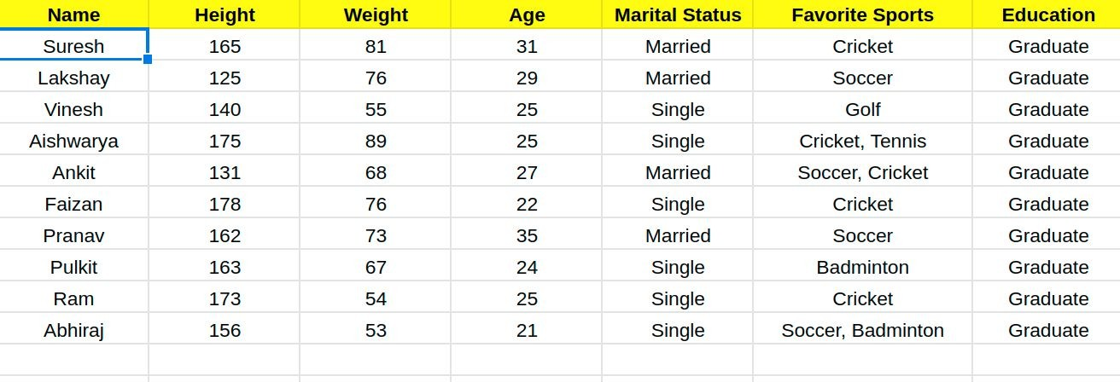
Multiple columns
Employee General Info:

Slide 6
Height in Cm
Names = [“Ramesh”, “Suresh”, “Sudesh”]
Height = [150, 145, 165]
Weight = [56, 60, 65]
Age = [23, 45, 58]
Weight in Kgs
Age in Years
Lists

Slide 7
Height in Cm
Names = [“Ramesh”, “Suresh”, “Sudesh”]
Height = [150, 145, 165]
Weight = [56, 60, 65]
Age = [23, 45, 58]
Weight in Kgs
Age in Years
Lists
.
.
Some info
How Many Lists?

Slide 8
Lists
Names = [“Ramesh”, “Suresh”, “Sudesh”]
Height = [150, 145, 165]
Weight = [56, 60, 65]
Age = [23, 45, 58]

Slide 9
Lists
Dictionary
employee_info = {
“names” : [“Ramesh”, “Suresh”, “Sudesh”],
“height” : [150, 145, 165],
“weight” : [56, 60, 65],
“age” : [23, 45, 58]
Names = [“Ramesh”, “Suresh”, “Sudesh”]
Height = [150, 145, 165]
Weight = [56, 60, 65]
Age = [23, 45, 58]
}

Slide 10
What is a Dictionary?
A dictionary is an unordered data structure.
Elements are separated by a comma and stored as key : value pair.
A dictionary is enclosed within curly brackets.
Some examples of Dictionary -
key : value, where value is a number
key : value, where value is a List

Slide 11
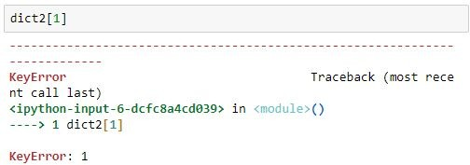
Accessing elements of a Dictionary
Elements are accessed by keys rather than index.
Dictionary accessed by index

Slide 12

Accessing elements of a Dictionary
Elements are accessed by keys rather than index.
Dictionary accessed by key

Slide 13
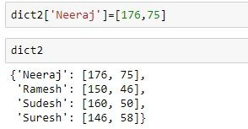
Adding elements to a Dictionary
Adding a single element

Slide 14
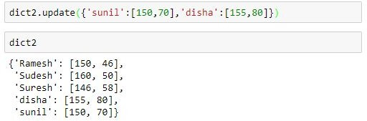
Adding elements to a Dictionary
Adding multiple elements at once

Slide 15
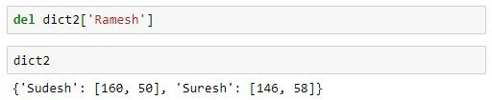
Deleting element of a Dictionary
Deleting an element

